Slide 1
Virtual Machines Virtual Memory
Ch 5
Prof Ann Marie Schilling

Slide 2
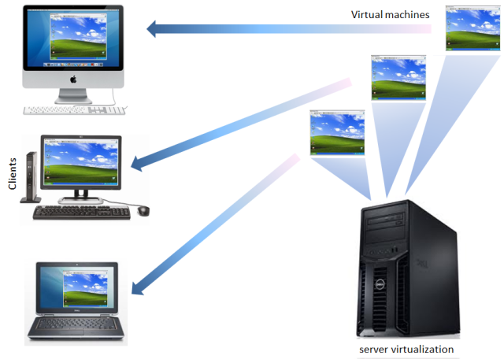
Virtual Machine

Slide 3
Virtual Machines
In a virtual machine, one processor is running many images of an emulator.
Each user sees one image. To this user, it looks as if he or she has control of the entire machine.
This is not true, however. The user is only using a portion of the processor given to it by the VM
This is why it’s a “virtual” machine and not just….
A machine

Slide 4
Virtual Machines
Some virtual machines run on native instruction sets, others emulate different sets

Slide 5
Virtual Machine Monitors
Software that manages the images is called a Virtual Machine Monitor or VMM
The VMM coordinates the hardware resources being used by the different images.
VMM isn’t a huge piece of code, just there to conduct traffic

Slide 6
Benefits of VMS
Increase protection
Protection - Assuring that different processes or users do not corrupt each others processes or data.
(This is different from …
Security – Assuring that external processes do not corrupted processes or data on the local machine.)

Slide 7
More benefits of VMS
Manage software
Images can be of different OS easing the major pain of versioning and backwards compatibility
Manage Hardware
Hardware can be shared by images
Can migrate image from one server to another for redundancy or load balancing

Slide 8
Requirements of VMMs
Software should behave exactly the same on VMM as on native host aside from performance. (why do we exclude performance?)
Guest software does not have ability to control hardware allocation directly
VMM has more privileges than Guest

Slide 9
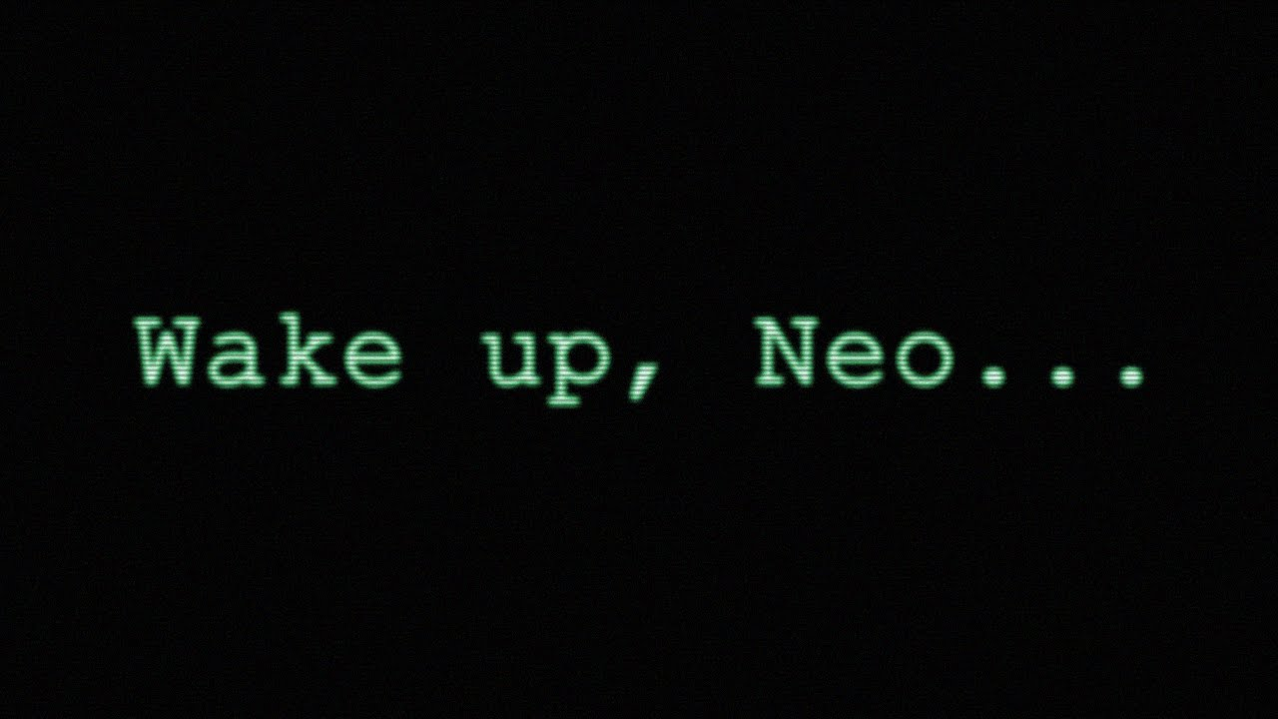
Virtual Memory

Slide 10
Virtual Memory
Virtual Memory is a fancy term for….
…using Main Memory (aka RAM) as a cache for disk
…making it appear to the processor that it can access an unlimited amount of memory rather than the small amount of memory the processor can directly access.
(what do we call that memory?)

Slide 11
Virtual Memory Purpose
Allow multiple VMs to share the same memory
Remove the burden of memory management from the application programmer
In other words, the application programmer doesn’t typically know the exact address of the code in memory. All the programmer knows is that it runs.

Slide 12
In other words…
Back in ancient times, programmers needed to assure their code fit into RAM. If it did not the programmer had to either….
Make it fit, dammit
Separate it into chunks
Load the code chunks into memory during run time using programming language constructs.

Slide 13
Virtual Addressing
A piece of data has one of two addresses:
Virtual – The address by which the processor accesses the data
Physical – The address where the data physically resides on disk

Slide 14
Terms
Page – A block of memory that is moved between disk and RAM
Page Fault – Occurs when the processor looks to the RAM for a page and it is not there.
Address Translation – Mapping a virtual address to a physical address and vice versa

Slide 15
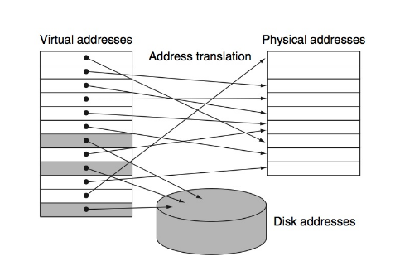
Address Translation High Level

Slide 16
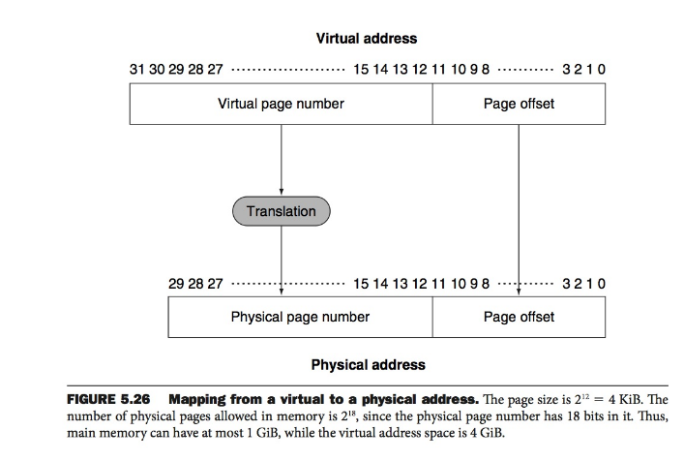
Address Mapping

Slide 17
Design Considerations
Main Memory access (latency) is about 100,000 times faster than disk.
Page Faults cost A LOT so we should….

Slide 18
Minimizing Page Faults
Large page size
Fully associative
Handle Page Faults in software
Avoid write through
Place Pages in RAM wisely

Slide 19
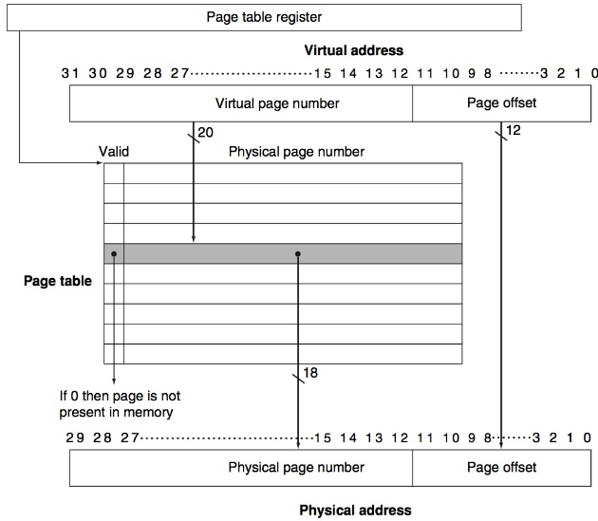
The Page Table

Slide 20
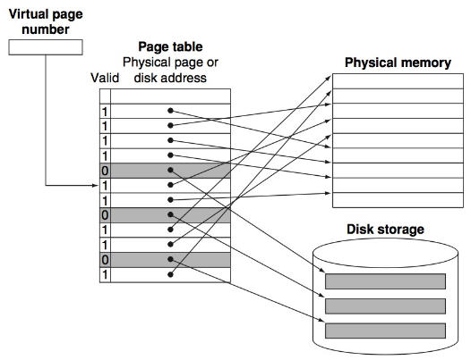
Another view of Page Table

Slide 21
Speeding Up Translation
Using the concepts of Temporal and Spatial locality, designers created another table which stores recently translated addresses.
This Translation Lookaside Buffer (TLB) acts as a cache for the page table.

Slide 22
TLB
As the TLB is a cache, the valid (dirty) bit is needed and a reference bit
When memory is referenced, the TLB is first consulted. If there is a miss, then the Page Table is examined.
To what is this similar on the processor?

Slide 23
TLB Miss?
What should happen next
What are our considerations?

Slide 24
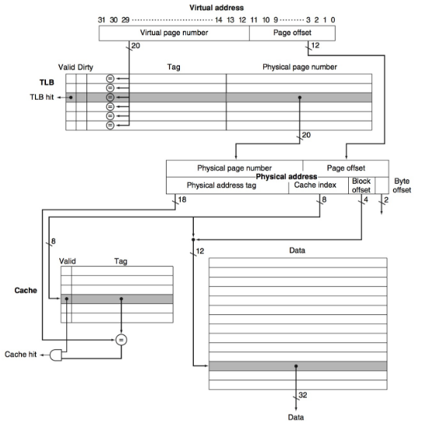

Slide 25
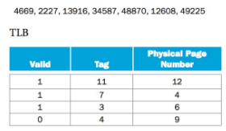
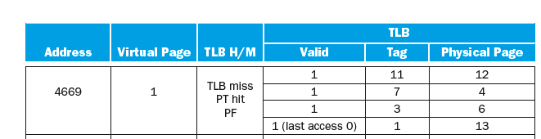
Hint for last Q on HW

